Slide 1
Dictionaries

Slide 2
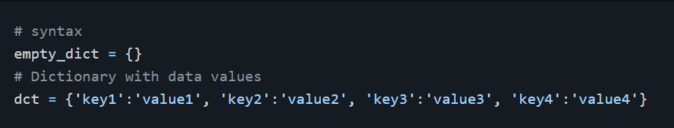
Dictionaries
A dictionary is a collection of unordered, modifiable(mutable) paired (key: value) data type.
Creating a Dictionary
To create a dictionary we use curly brackets, {} or the dict() built-in function.

Slide 3
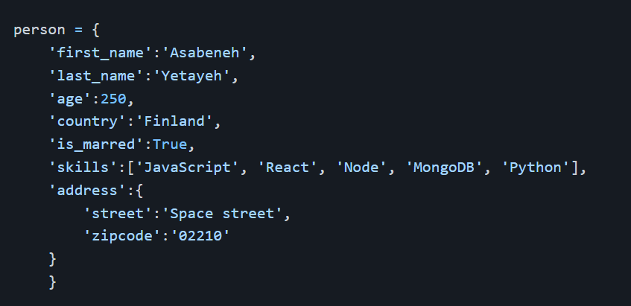
Example:
The dictionary above shows that a value could be any data types:string, boolean, list, tuple, set or a dictionary.

Slide 4
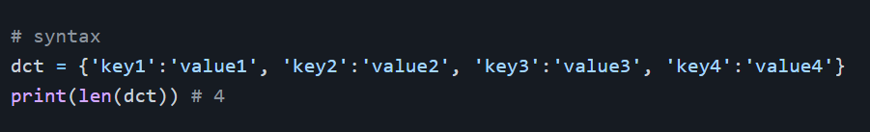
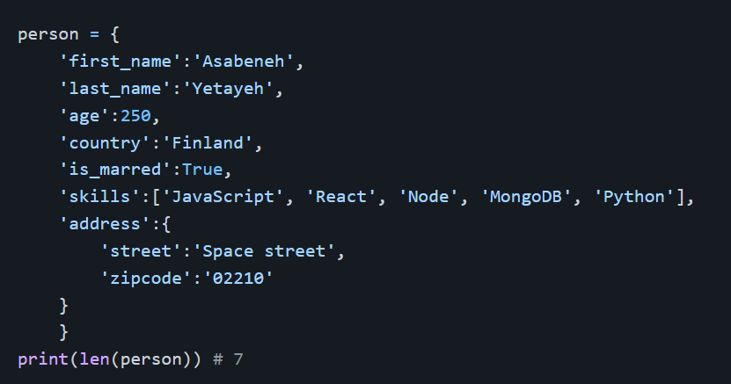
Dictionary Length
It checks the number of 'key: value' pairs in the dictionary.
Example:

Slide 5
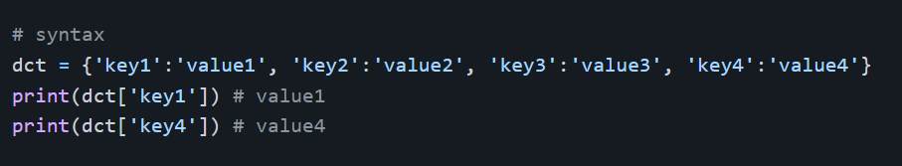
Accessing Dictionary Items
We can access Dictionary items by referring to its key name.
Example:

Slide 6
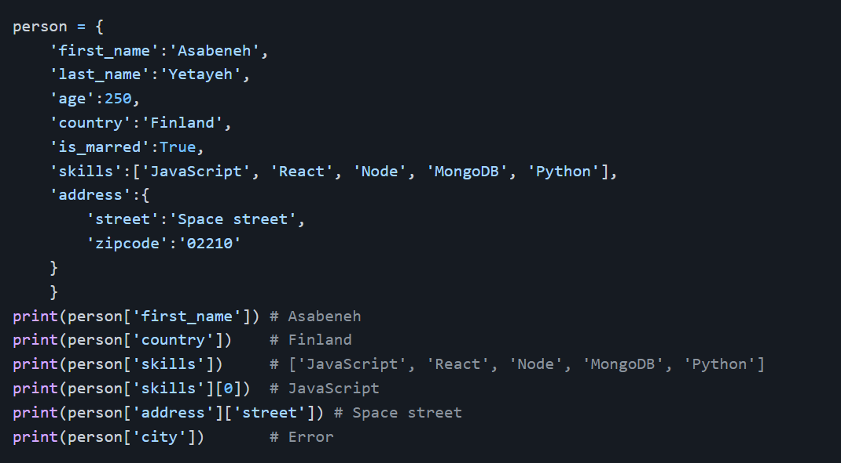

Slide 7
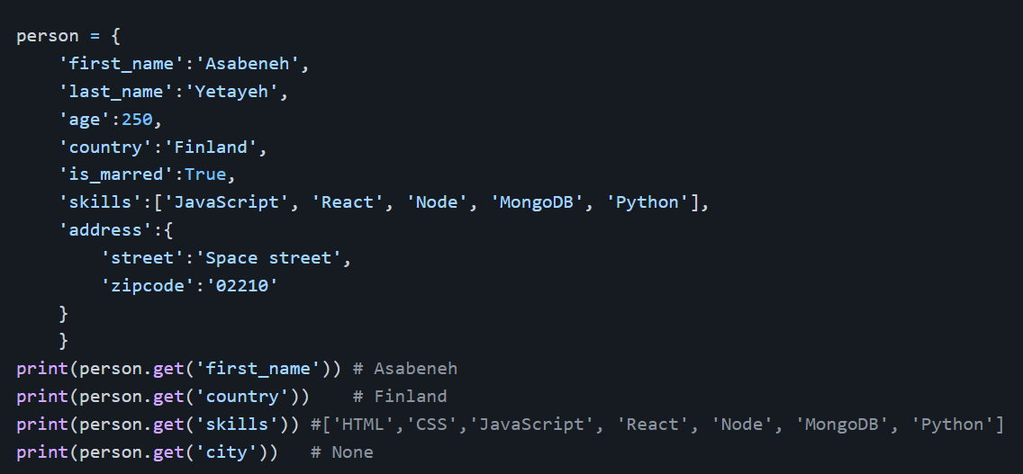
Accessing an item by key name raises an error if the key does not exist. To avoid this error first we have to check if a key exist or we can use the get method. The get method returns None, which is a NoneType object data type, if the key does not exist.

Slide 8
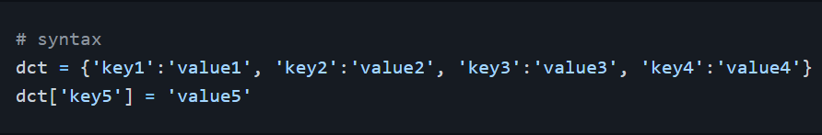
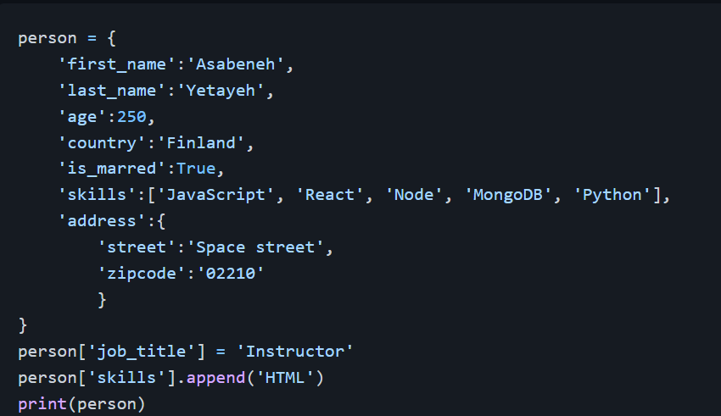
Adding Items to a Dictionary
We can add new key and value pairs to a dictionary
Example:

Slide 9
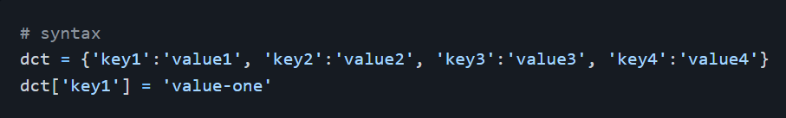
Modifying Items in a Dictionary
We can modify items in a dictionary

Slide 10
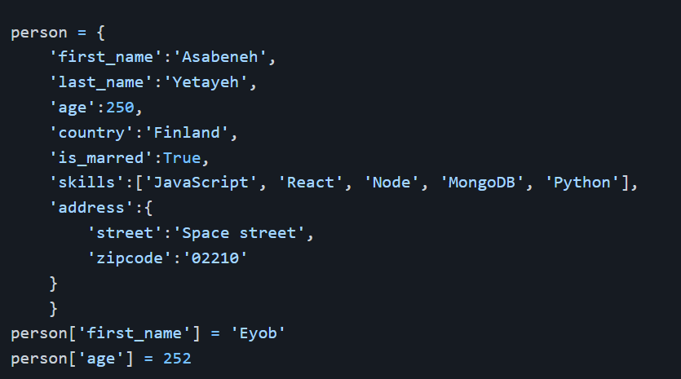
Example:

Slide 11
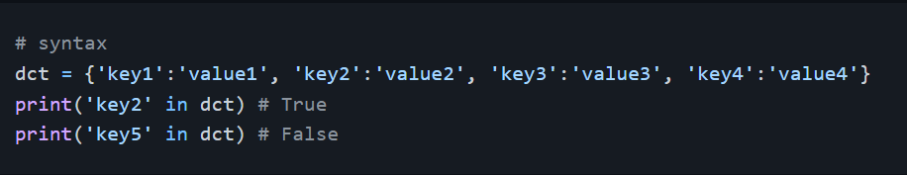
Checking Keys in a Dictionary
We use the in operator to check if a key exist in a dictionary

Slide 12
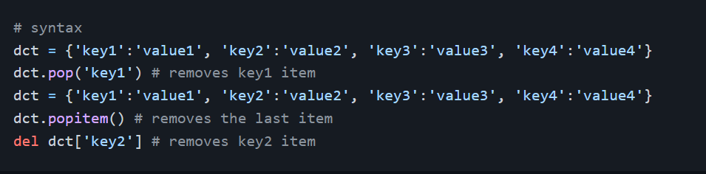
Removing Key and Value Pairs from a Dictionary
pop(key): removes the item with the specified key name:
popitem(): removes the last item
del: removes an item with specified key name

Slide 13
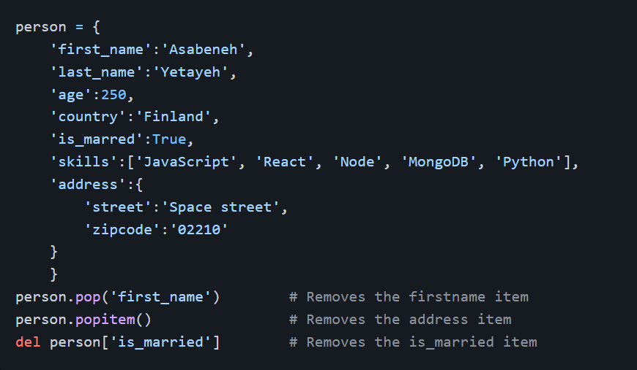
Example:

Slide 14
Changing Dictionary to a List of Items
The items() method changes dictionary to a list of tuples.

Slide 15
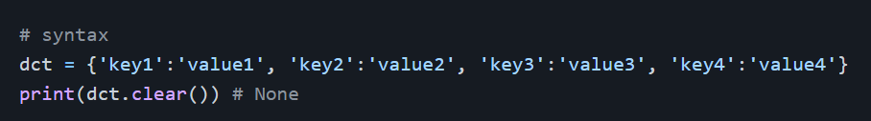
Clearing a Dictionary
If we don't want the items in a dictionary we can clear them using clear() method

Slide 16
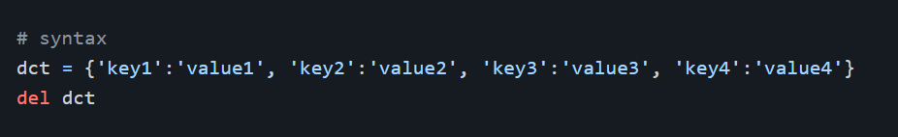
Deleting a Dictionary
If we do not use the dictionary we can delete it completely

Slide 17
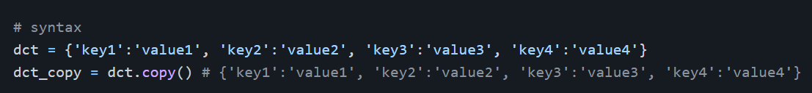
Copy a Dictionary
We can copy a dictionary using a copy() method. Using copy we can avoid mutation of the original dictionary.

Slide 18
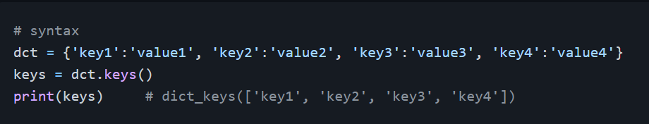
Getting Dictionary Keys as a List
The keys() method gives us all the keys of a a dictionary as a list.

Slide 19
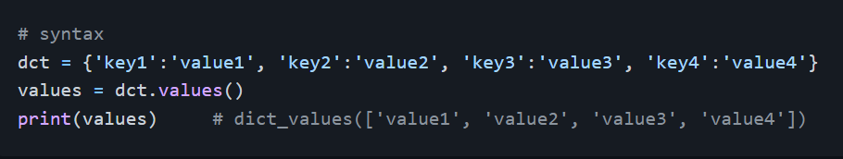
Getting Dictionary Values as a List
The values method gives us all the values of a a dictionary as a list.

Slide 20
Exercises: Day 8
Create an empty dictionary called dog
Add name, color, breed, legs, age to the dog dictionary
Create a student dictionary and add first_name, last_name, gender, age, marital status, skills, country, city and address as keys for the dictionary
Get the length of the student dictionary
Get the value of skills and check the data type, it should be a list

Slide 21
Modify the skills values by adding one or two skills
Get the dictionary keys as a list
Get the dictionary values as a list
Change the dictionary to a list of tuples using items() method
Delete one of the items in the dictionary
Delete one of the dictionaries

